Slide 1

Working principle of USB interface
Md. Fazle Rabbi
ID:16CSE057

Slide 2
Contents
What is usb?
History of usb
USB pipe model
Sequence of Enumeration Events
different data transfer types
USB Architecture
USB Connections

Slide 3
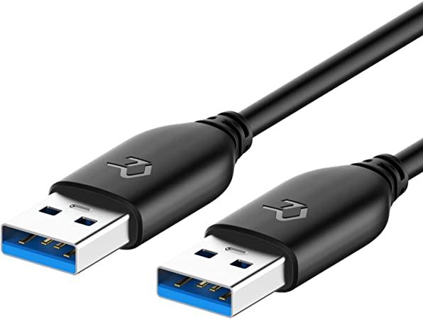
What is usb?
USB stands for Universal Serial Bus.
The standard that is used to connect peripherals to a computer.
The most commonly used port.
It’s Universal.
[1]

Slide 4
History of usb?
NAME | SPEED
USB 1.0 | 1.5 Mbit/s
USB 1.1 | 12 Mbit/s
USB 2.0 | 480 Mbit/s
USB 3 | 4.8 Gbit/s
USB 3.1 | 10 Gbit/s
USB 3.2 | 20 Gbit/s
USB 4 | 40 Gbit/s

Slide 5
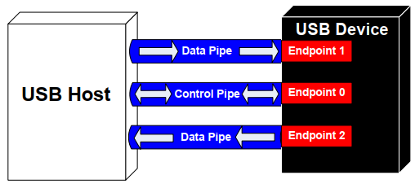
USB pipe model
USB device communication is done through pipes. There are two types of pipes in a USB system,
control pipes and
data pipes.

Slide 6
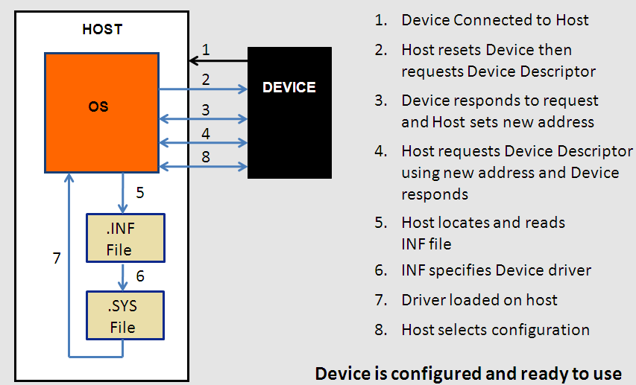
Sequence of Enumeration Events

Slide 7
different data transfer types
Control Transfers Used for sending commands to the device, make inquiries, and configure the device. This transfer uses the control pipe
Interrupt Transfers Used for sending small amounts of bursty data that requires a guaranteed minimum latency. This transfer uses a data pipe
Bulk Transfers Used for large data transfers that use all available USB bandwidth with no guarantee on transfer speed or latency. This transfer uses a data pipe
Isochronous Transfers Used for data that requires a guaranteed data delivery rate. Isochronous transfers are capable of this guaranteed delivery time due to their guaranteed latency, guaranteed bus bandwidth, and lack of error correction. Without the error correction, there is no halt in transmission while packets containing errors are resent. This transfer uses a data pipe.

Slide 8
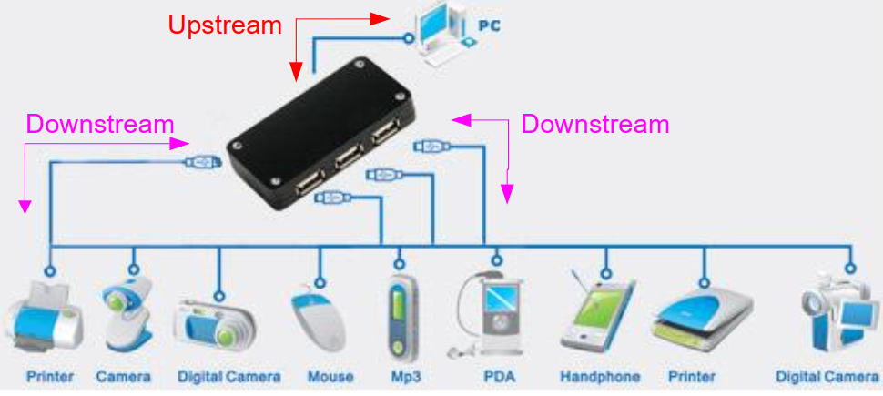
USB Architecture

Slide 9
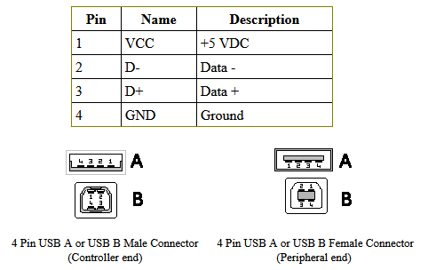
USB A, B 2.0 and 3.0 Cable Pinout
[5]

Slide 10
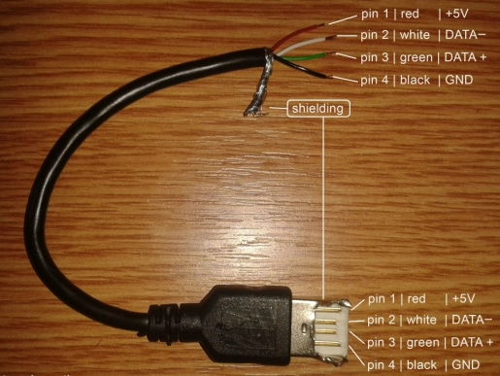
USB A, B 2.0 and 3.0 Cable Pinout
[6]

Slide 11
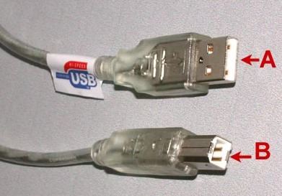
USB Connections
It consists 2 connectors:
A type
B type
[2]

Slide 12
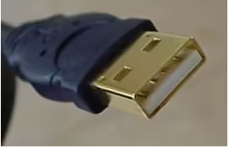
USB Connections
A type connectors:
"A" connectors head "upstream" toward the computer.
[3]

Slide 13
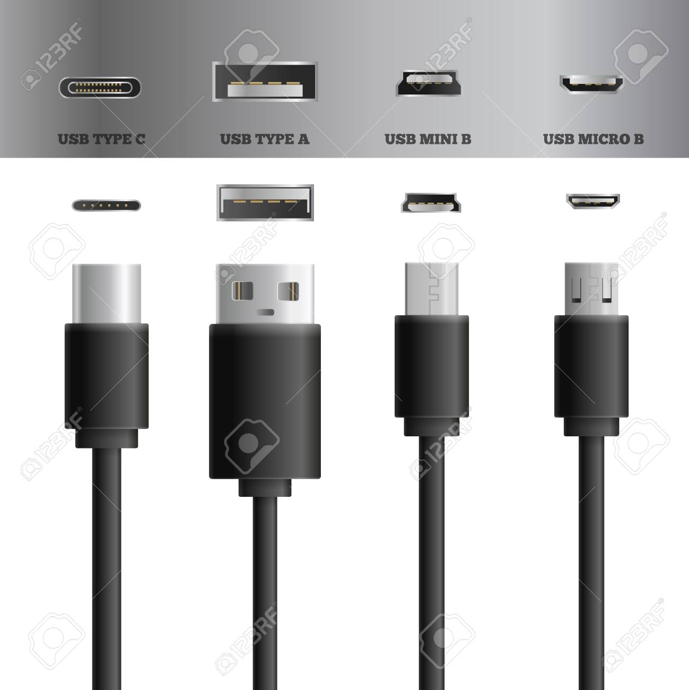
USB Connections
B type connectors:
B" connectors head "downstream" and connect to individual devices.
[4]

Slide 14
References
https://m.media-amazon.com/images/I/61Dwrp7qfCL._AC_SY450_.jpg
https://www.electroschematics.com/wp-content/uploads/2010/01/USB-AB-CONNECTORS.png?resize=400%2C317?w=400
https://media.hswstatic.com/eyJidWNrZXQiOiJjb250ZW50Lmhzd3N0YXRpYy5jb20iLCJrZXkiOiJnaWZcL3VzYjEuanBnIiwiZWRpdHMiOnsicmVzaXplIjp7IndpZHRoIjoyNzN9LCJ0b0Zvcm1hdCI6ImF2aWYifX0=
https://media.hswstatic.com/eyJidWNrZXQiOiJjb250ZW50Lmhzd3N0YXRpYy5jb20iLCJrZXkiOiJnaWZcL3VzYjYuanBnIiwiZWRpdHMiOnsicmVzaXplIjp7IndpZHRoIjoyNjJ9LCJ0b0Zvcm1hdCI6ImF2aWYifX0=
https://www.pc-control.co.uk/usb%20pinout.htm
https://www.electroschematics.com/wp-content/uploads/2010/01/usb-wiring-connection.jpg?resize=550%2C412

Slide 15
THE END

